Slide 1
Alabama Vikings Intro to Canning
Joshua and Ashley Putman

Slide 2
Useful references
https://www.ballmasonjars.com/
https://www.lehmans.com/
https://www.brescoinc.com/
https://www.allamerican1930.com/products/the-925-pressure-cooker
https://www.kerrhomecanning.com/

Slide 3
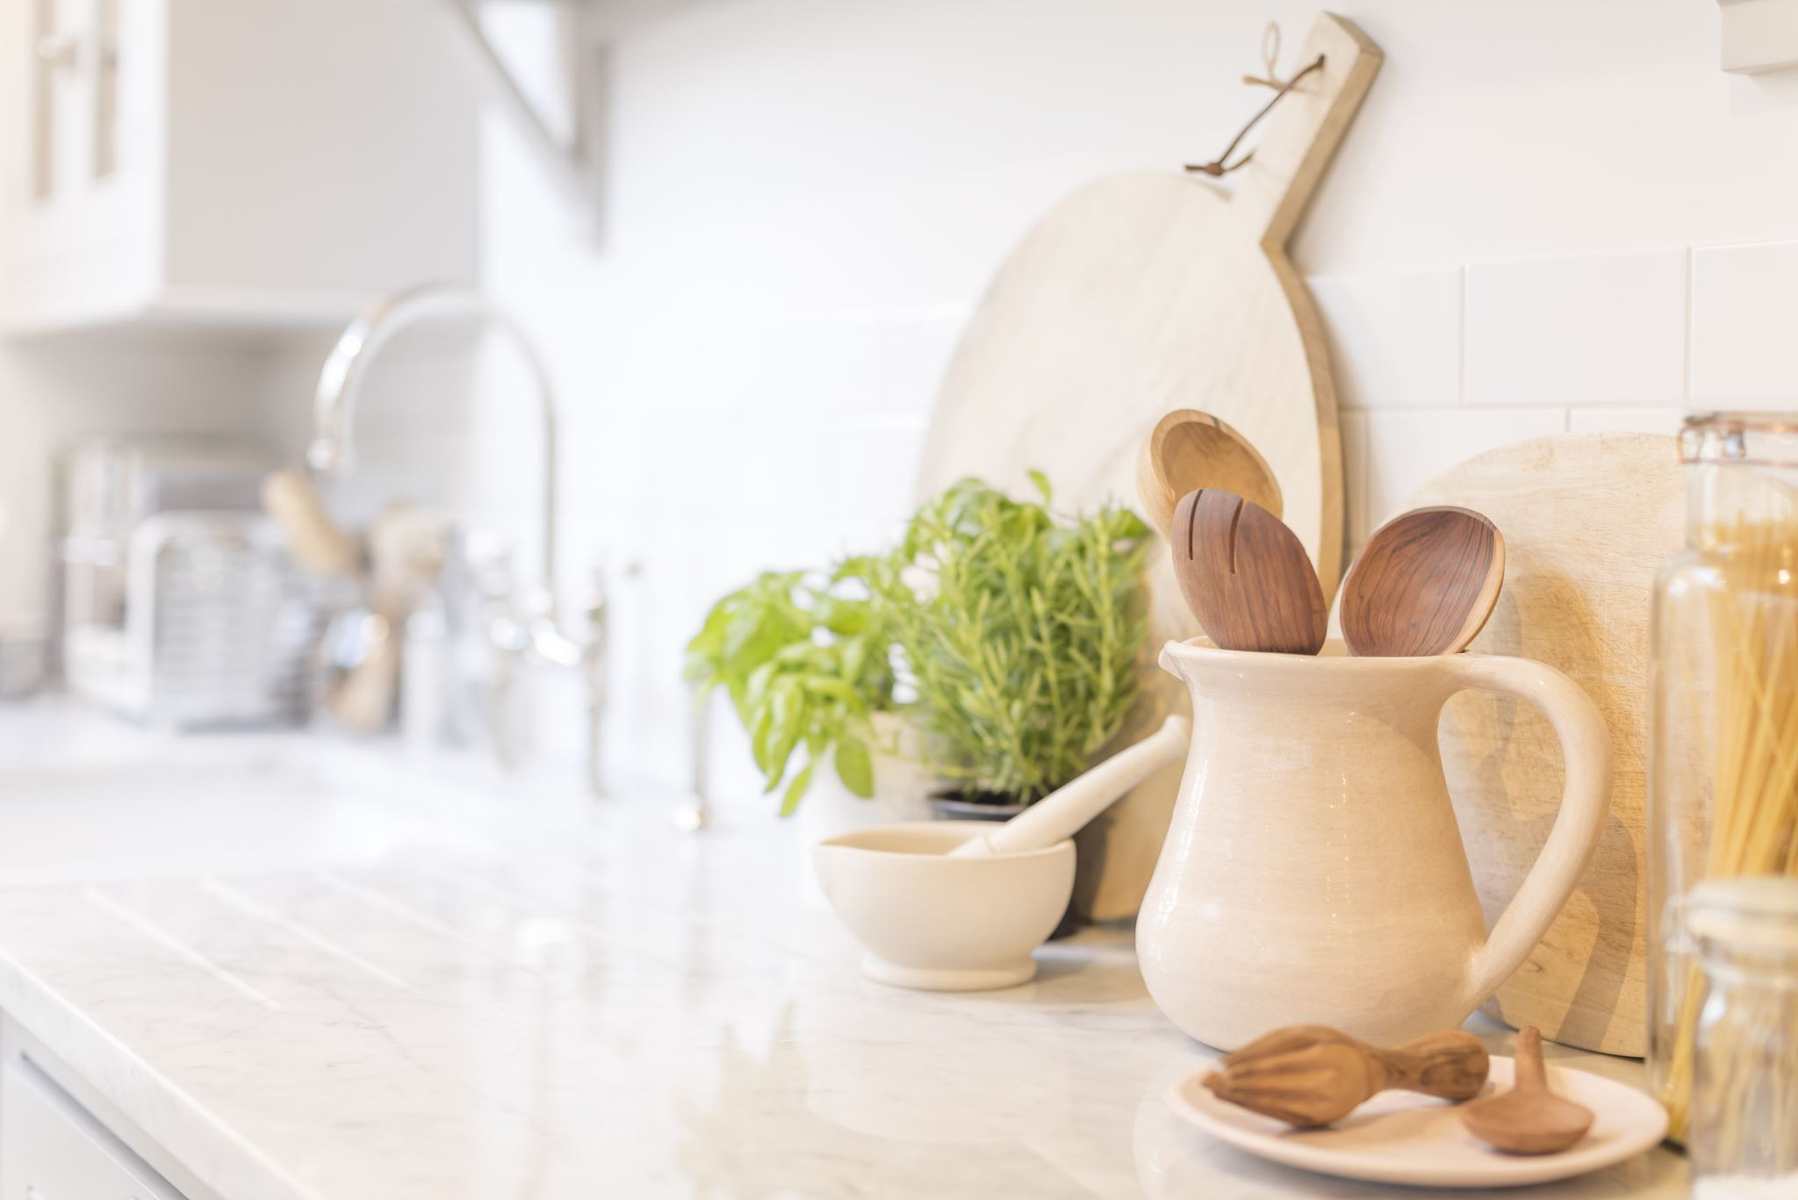
Marley was Dead; to begin with. –just kidding
Preparedness with canning– our short story.
We had done very little canning before COVID , just a few fig preserves in water bath. During COVID canning supplies were scarce (the great lid shortage). We began to explore methods of food preservation. We had limited freezer space. We started with vacuum sealing high value foods (especially proteins). Bare grocery shelves really made an impression on us how tenuous our supply chain can be. As we acquired more staples and frozen items the reality of a power outage severely compromising our supplies started to weigh heavy on us. We looked at salt preserving, dehydrating, and especially canning.

Slide 4
Types of Canning
Water Bath Canning / Pickling | Pressure Canning
High Acid Foods | Low Acid Foods
Fruits – Jams, Jellies, Marmalade, etc. | Vegetables (not pickled)
Tomatoes and Tomato based foods (NOTHING WITH MEAT) | Meats
 | Combination Recipes – Stews, Chilis, etc.
*Pickling includes some vegetables

Slide 5
Health & Food SAFETY
Inspect
jars, lids, bands, and cookers
Sanitize
Wash with hot soapy water.
Rinse in hot water.
Optional: Steam on top rack of Dish Washer.
Recipe
Be sure to follow your recipe directions.
Use trusted and well-known recipes.
Storage
Store out of direct sunlight in a cool and dry place.
Remove bands.
Do not stack jars or allow items to be stored on top of jars.
Label your jars with what is in the jar and date it was canned.
Use
Always inspect your jars for any leaks, cracks or broken seals before use.
Discard any food you are uncomfortable with.

Slide 6
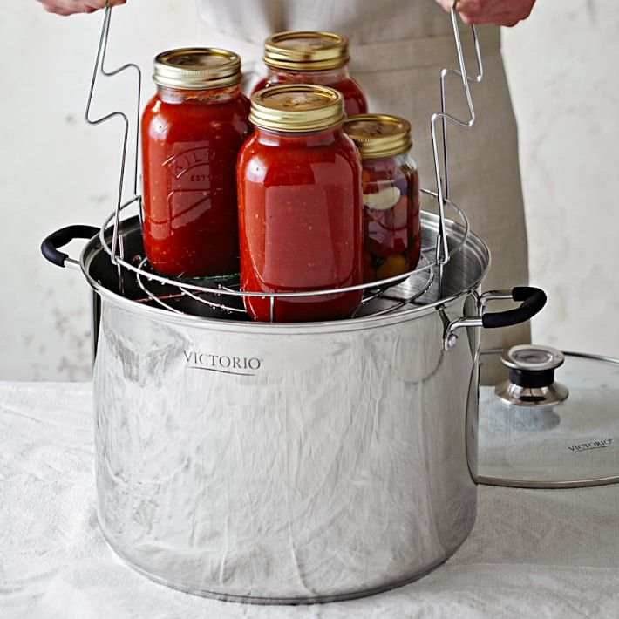
Water bath canning
Equipment:
Stock Pot
Rack
Funnel
Headspace Tool (Bubble Remover)
Jar Lifter
Jars / Lids / Rings
Towels
Optional: Vinegar

Slide 7
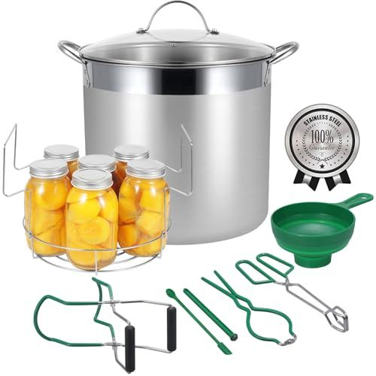
Water bath canning
I found this on Amazon this morning for 79.99.
*note ours was pulled together.

Slide 8
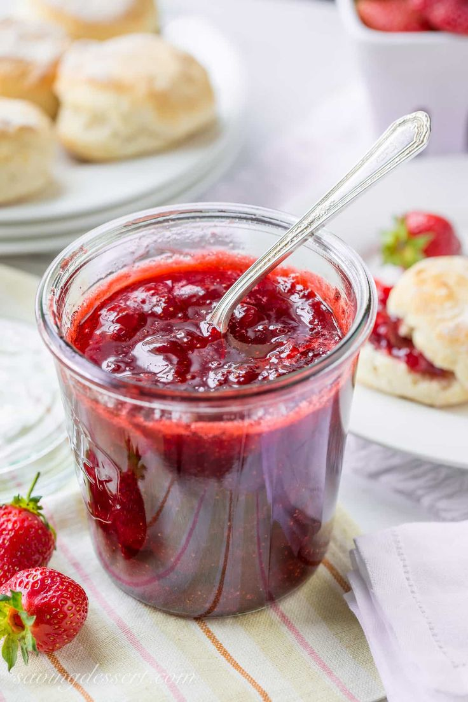
Water bath canning
Process –
Prepare high acid foods as discussed.
Follow trusted recipes.
Fill sanitized jars with your food paying attention to head space and air bubbles. (Prewarm your jars if you are adding hot food – this prevents the glass from being shocked and cracking,)
Jars are totally submerged in water and covered by an 1” of water.
Water is brough up to a rolling boil and kept there through the processing time.

Slide 9
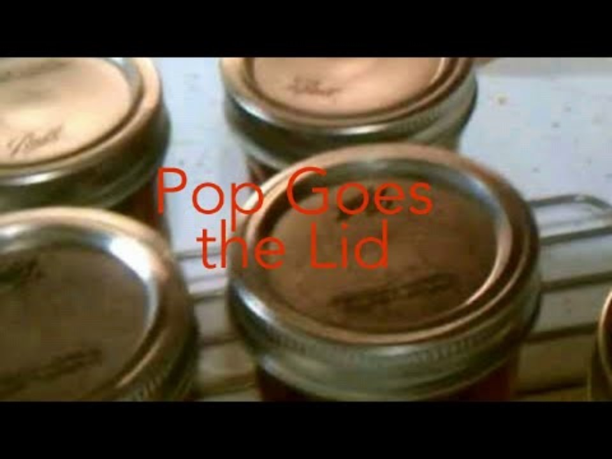
Water bath canning
Process –
Boiling (212f) and processing time destroys mold, yeast, some bacteria, and inactivates enzymes in the food that leads to degradation and spoilage. – After time remove the jars from bath. You will set these aside to cool where they are not touching . As the jars cool the lids will POP as the vacuum seal is created.

Slide 10
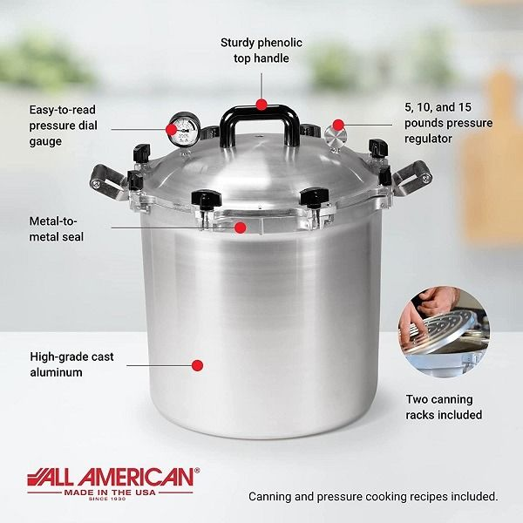
Pressure canning
Equipment:
Pressure Canner
Rack
Funnel
Headspace Tool (Bubble Remover)
Jar Lifter
Jars / Lids / Rings
Towels
Optional: Vinegar

Slide 11
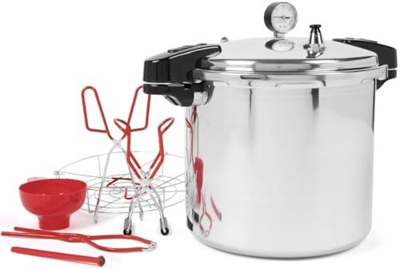
pressure canning
I found this on Amazon this morning for $152.13.
The All American version shown on previous slide can be bought from Lehmans for $419.95.

Slide 12
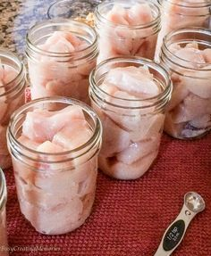
Pressure canning
Process – FOLLOW THE RECIPE
Prepare low acid foods as discussed.
Follow trusted recipes.
Fill sanitized jars with your food paying attention to head space and air bubbles. Recipes vary on pre-warming jars – FOLLOW THE RECIPE.
This process uses steam and not boiling water. Water levels in bottom of cookers can vary. Be sure to follow your manufacturers directions on water level.
FOLLOW THE RECIPE

Slide 13
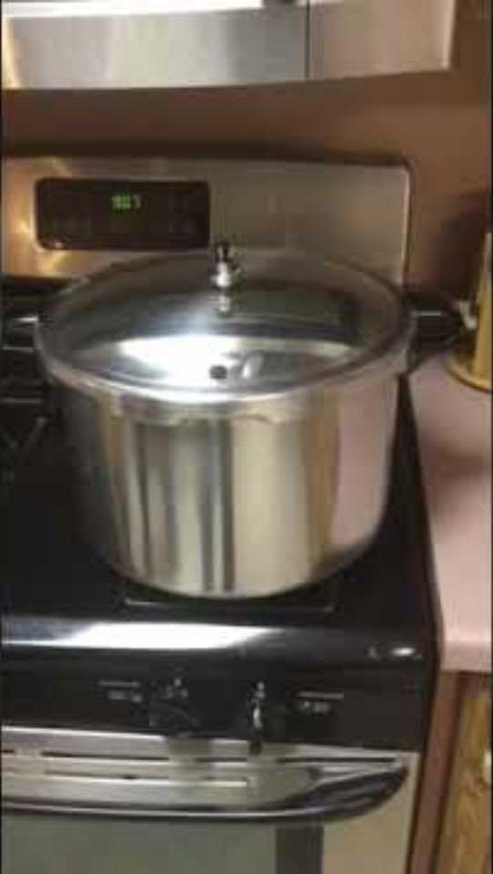
pressure canning
Process –
Once the lid is locked into position and the canner is slowly brought to temperature, steam will build inside the vessel.
The canner must be maintained at temperature to ensure the proper pressure. (Most foods are cooked at the same pressure dependent on your elevation.)
FOLLOW THE RECIPE
The internal temperature will reach 240f which cannot be reached by boiling. This kills mold, yeast, bacteria, and inactivates enzymes that lead to food degradation and spoilage.
FOLLOW THE RECIPE and can your food for the appropriate amount of TIME at PRESSURE.
Once time has been reached, remove from heat and allow the pressure to come down naturally. This can be an extended process… TRUST THE PROCESS.
Jars are removed from the canner in the same manner as in water bath canning above.

Slide 14
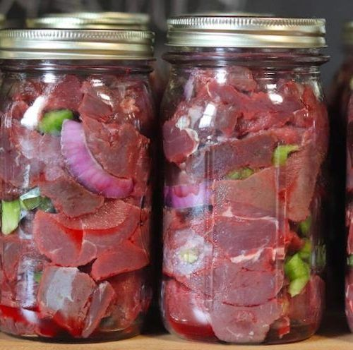
Storage & Use
Storage
Store out of direct sunlight in a cool and dry place.
Remove bands.
Do not stack jars or allow items to be stored on top of jars.
Label your jars with what is in the jar and date it was canned.
Use
Always inspect your jars for any leaks, cracks or broken seals before use.
Discard any food you are uncomfortable with.

Slide 15
dANGERS
Foodborne botulism
Use proper techniques when canning or preserving foods at home to make sure botulism germs are destroyed. It's also important to prepare and store food safely:
Pressure-cook home-canned foods at 250 degrees Fahrenheit (121 Celsius) for 20 to 100 minutes, depending on the food.
Think about boiling these foods for 10 minutes before serving them.
Don't eat preserved food if its container is bulging or if the food smells bad. But, taste and smell won't always give away the presence of C. botulinum. Some strains don't make food smell bad or taste unusual.
If you wrap potatoes in foil before baking, eat them hot. Loosen the foil and store the potatoes in the refrigerator — not at room temperature.
Store homemade oils infused with garlic or herbs in the refrigerator. Throw them out after four days.
Refrigerate canned foods after you open them.
https://www.mayoclinic.org/diseases-conditions/botulism/symptoms-causes/syc-20370262

